Slide 1
step
half
climb higher

Slide 2
- fi
med
prototype
Prototype Link

Slide 3
outline
about half step
tasks
revised interface design
prototype overview
Notes:
Selected INterface and rational Low-fi prototype structure (1 slide – mainly images)

Slide 4
step
half
climb higher

Slide 5

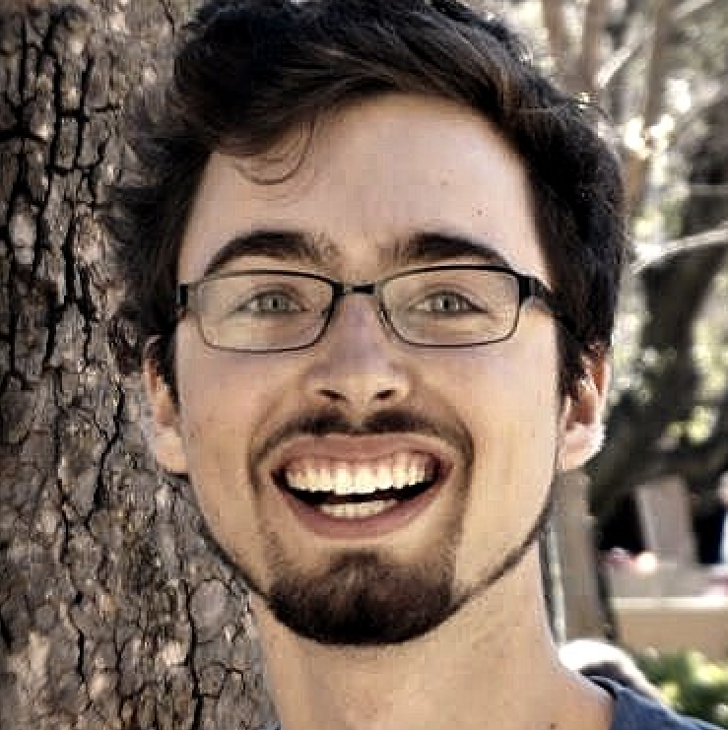
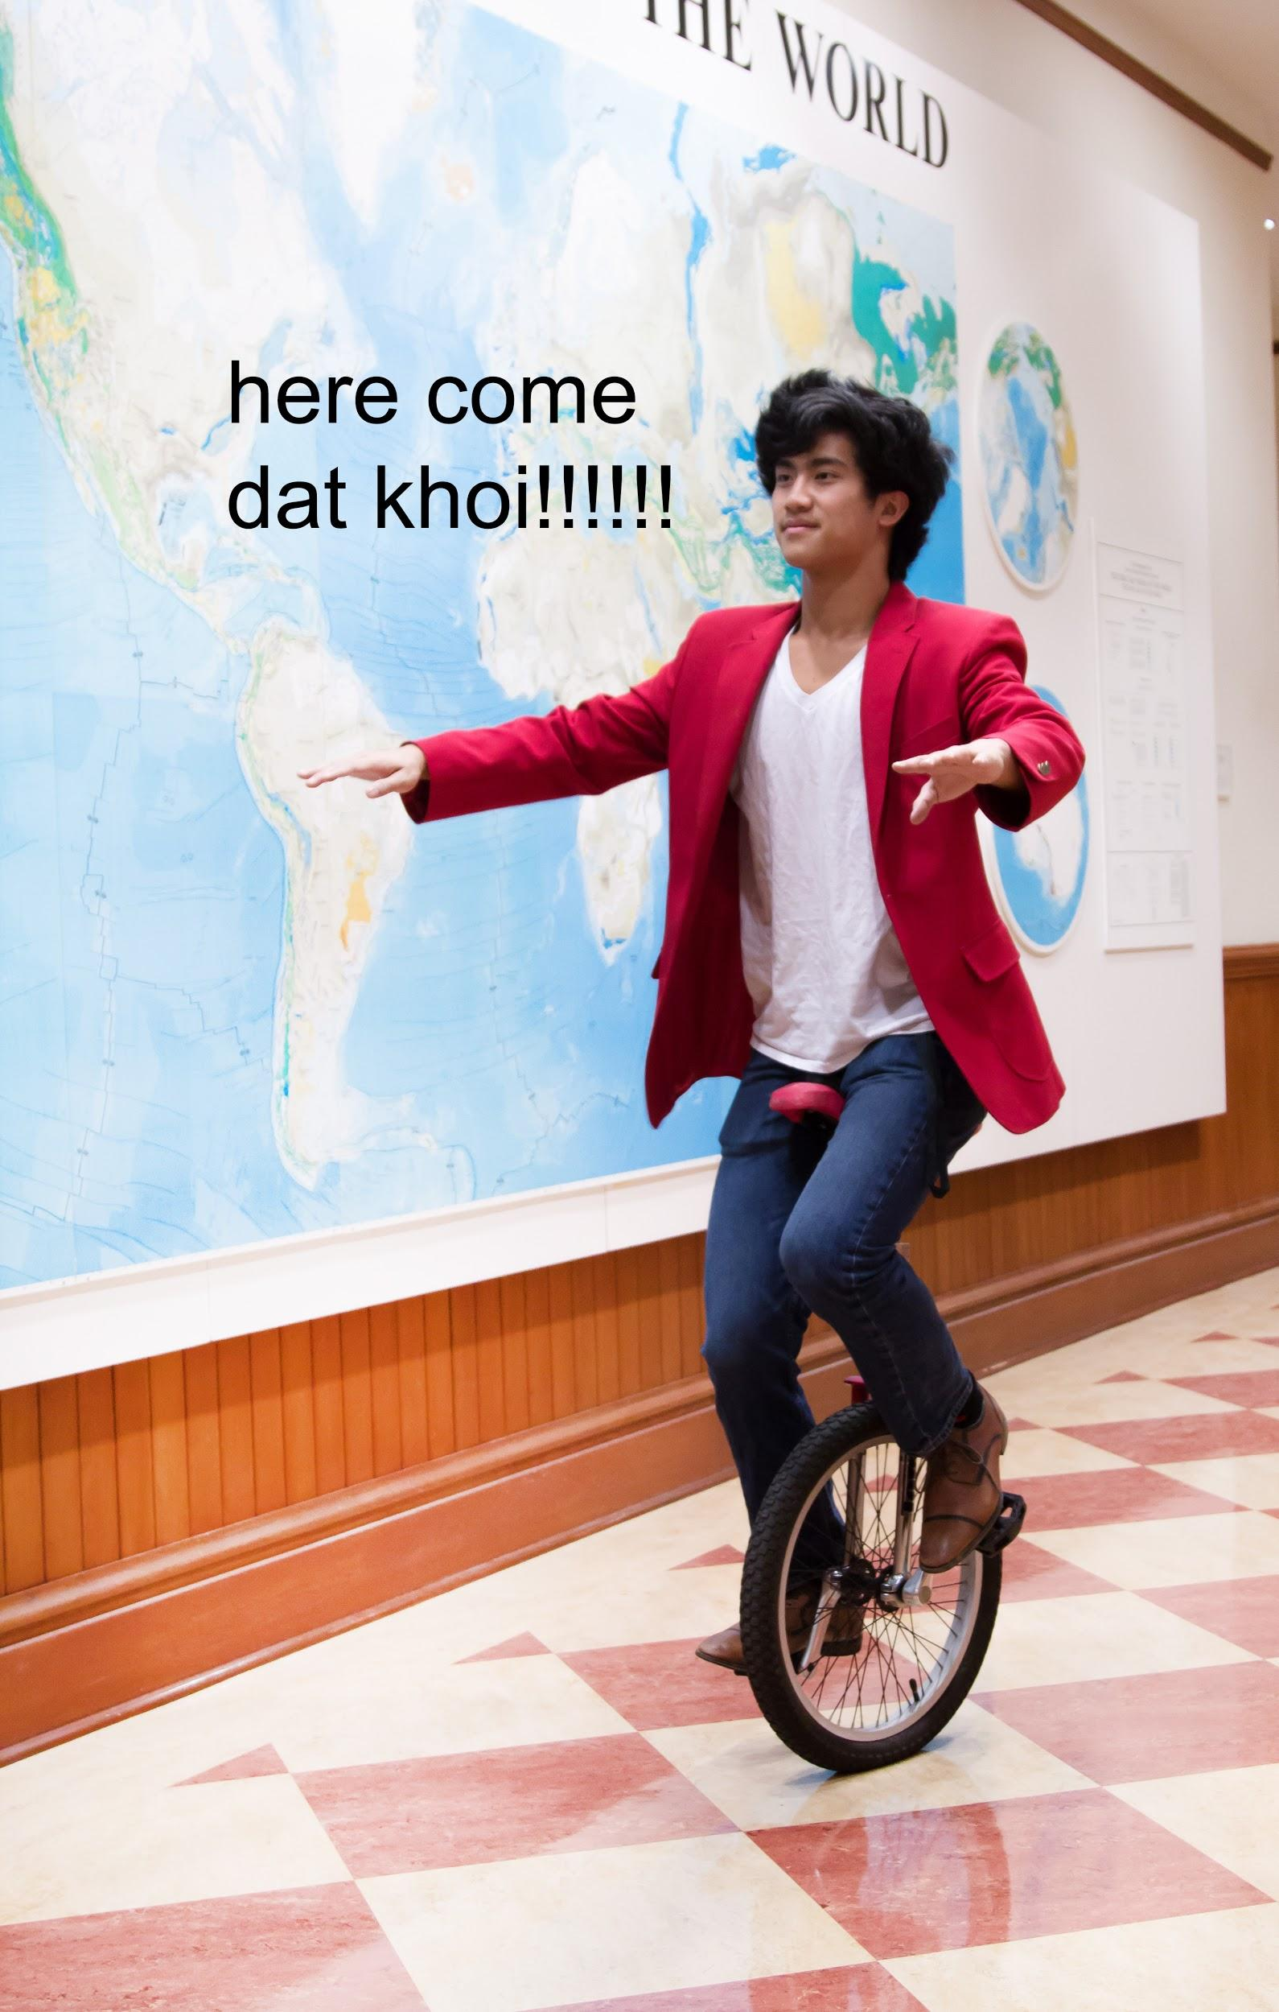
Stefan Swaans
B.S CS 2018
David Mora
B.S CS 2018
Khoi Le
B.S SymSys 2020

Slide 6
learn
m u s i c
one step at a time

Slide 7
Music practice can be unfocused, filled with self-doubt, lonely, and disconnected from your goals and dreams.
half step helps you climb higher by providing bite-sized tasks, near-peer support, and progress tracking.

Slide 8
tasks
reworded to focus on learning
Notes:
Selected INterface and rational Low-fi prototype structure (1 slide – mainly images)

Slide 9
old
simple
complete current lesson
medium
add new music learning goal
complex
find someone on the same step to meet and learn with

Slide 10
new
simple
learn next “skill bite”
medium
add new music learning goal
complex
find someone learning the same thing as you to be inspired by
Notes:
underliend == changed

Slide 11
revised interface design
3 biggest changes
Notes:
Selected INterface and rational Low-fi prototype structure (1 slide – mainly images)

Slide 12
change 1: redefine & design social support
Notes:
Selected INterface and rational Low-fi prototype structure (1 slide – mainly images)

Slide 13
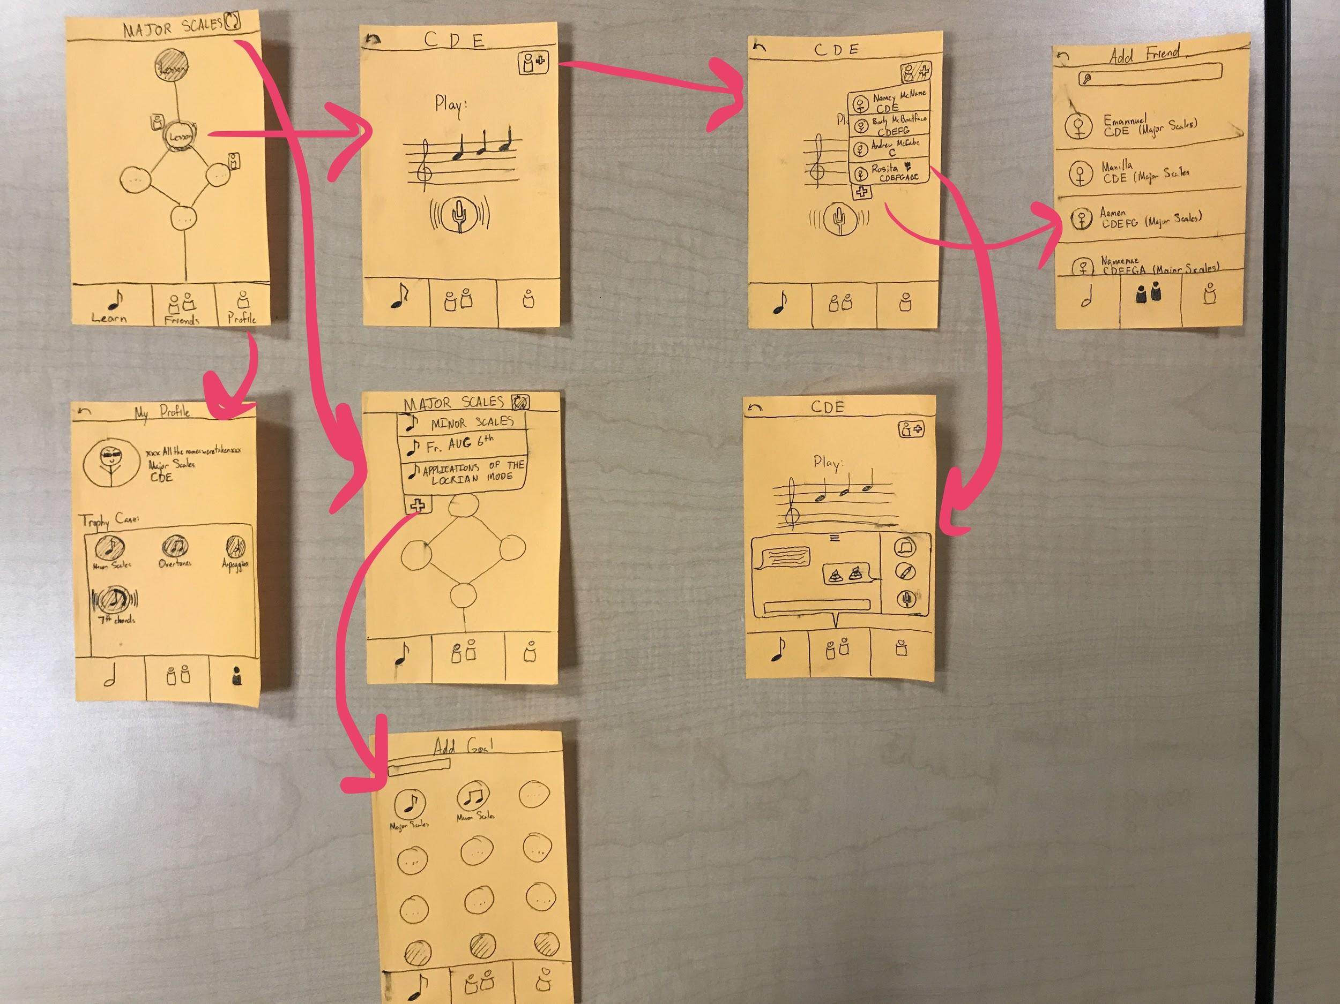
issues:
adding friend unintuitive
interfears with practice
old
Notes:
Selected INterface and rational Low-fi prototype structure (1 slide – mainly images)

Slide 14
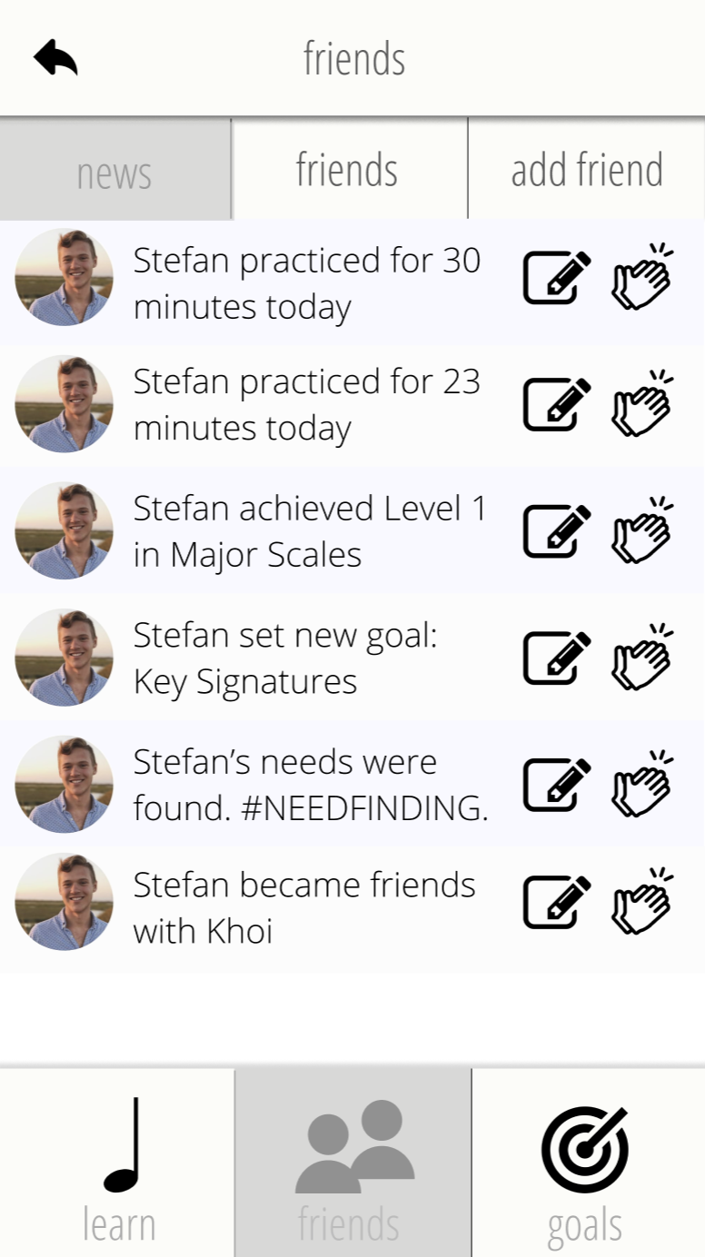
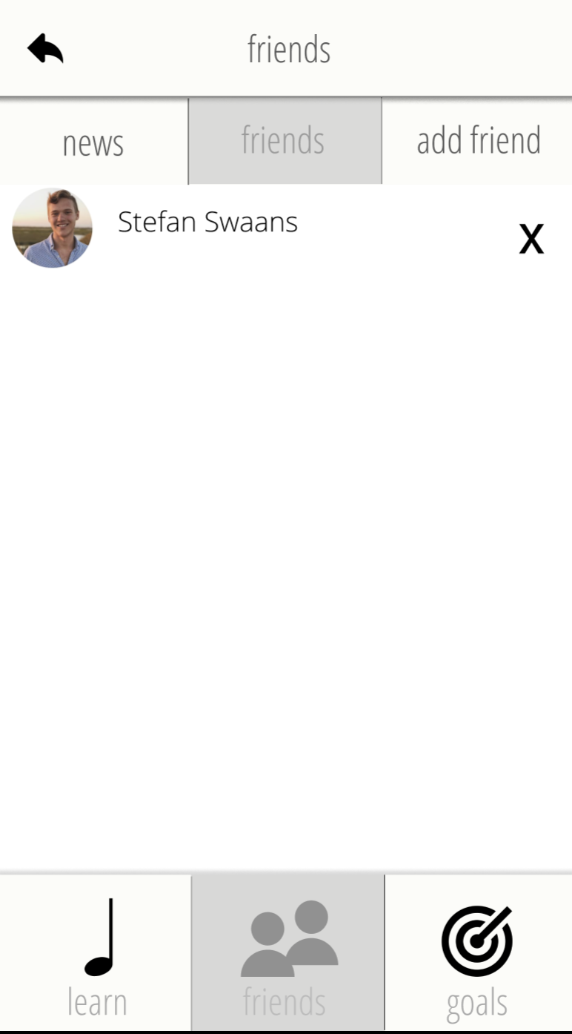
redesigns:
tab view
get inspired via “news”
clearer adding interface
new
Notes:
Selected INterface and rational Low-fi prototype structure (1 slide – mainly images)

Slide 15
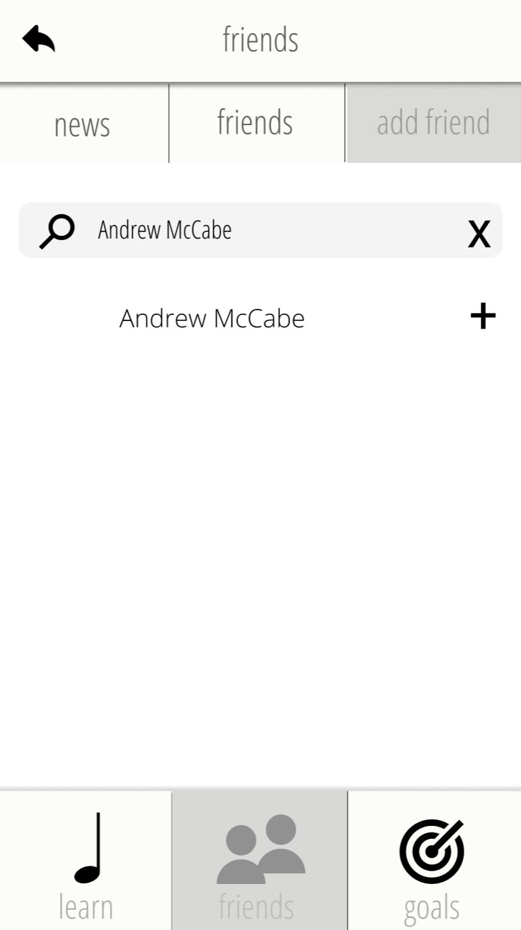
redesigns:
tab view
get inspired via “news”
clearer adding interface
new
Notes:
Selected INterface and rational Low-fi prototype structure (1 slide – mainly images)

Slide 16
change 2: redesign goal setting & finishing
Notes:
Selected INterface and rational Low-fi prototype structure (1 slide – mainly images)

Slide 17
issues:
progression unclear
difficult to asses what goals entail
old
Notes:
Selected INterface and rational Low-fi prototype structure (1 slide – mainly images)

Slide 18
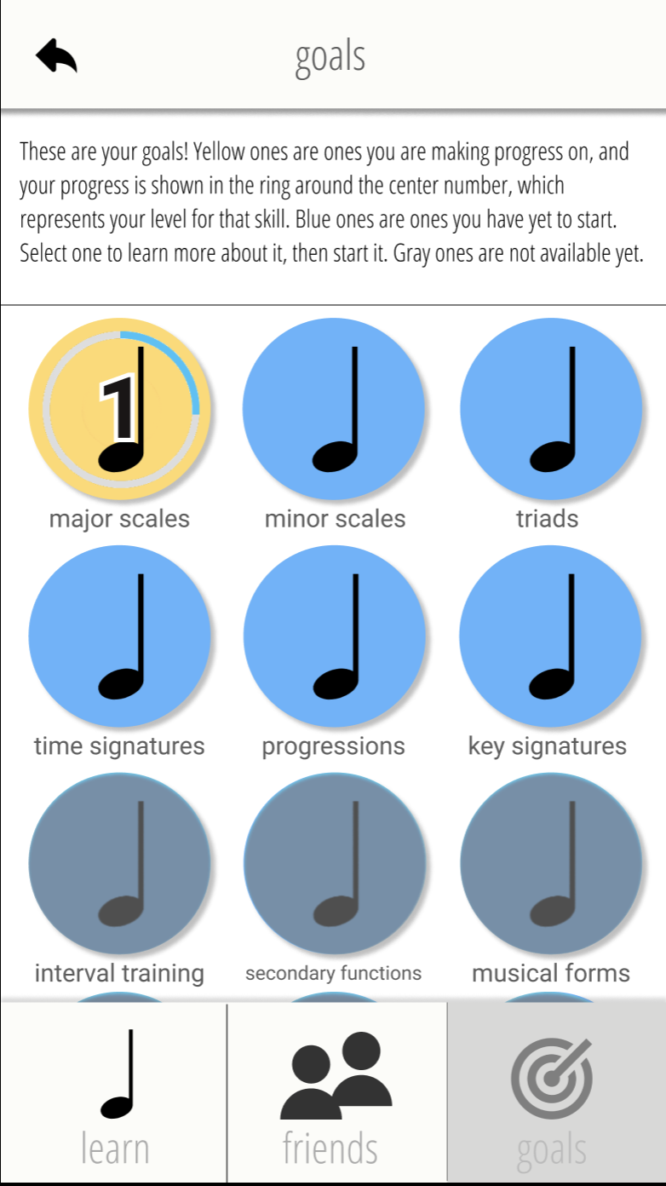
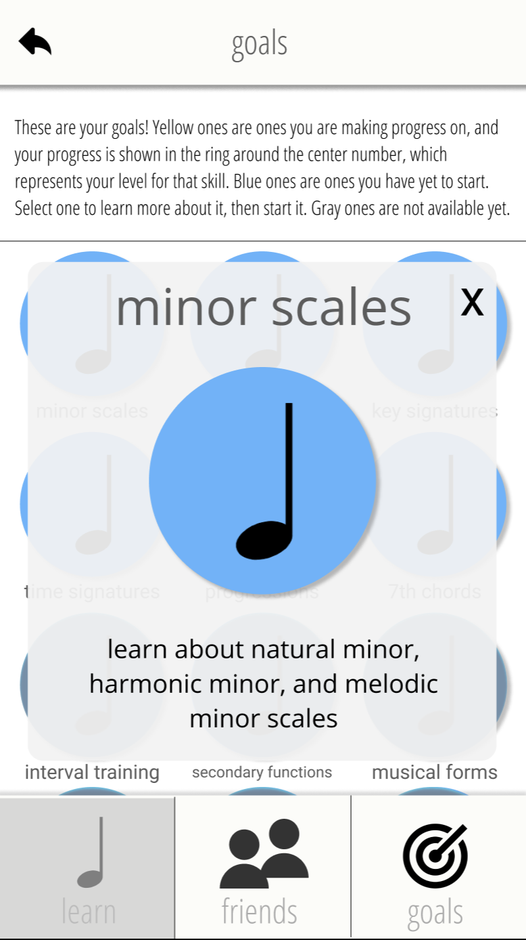
redesigns:
color indicates status
info popup
progress arc
Notes:
Selected INterface and rational Low-fi prototype structure (1 slide – mainly images)

Slide 19
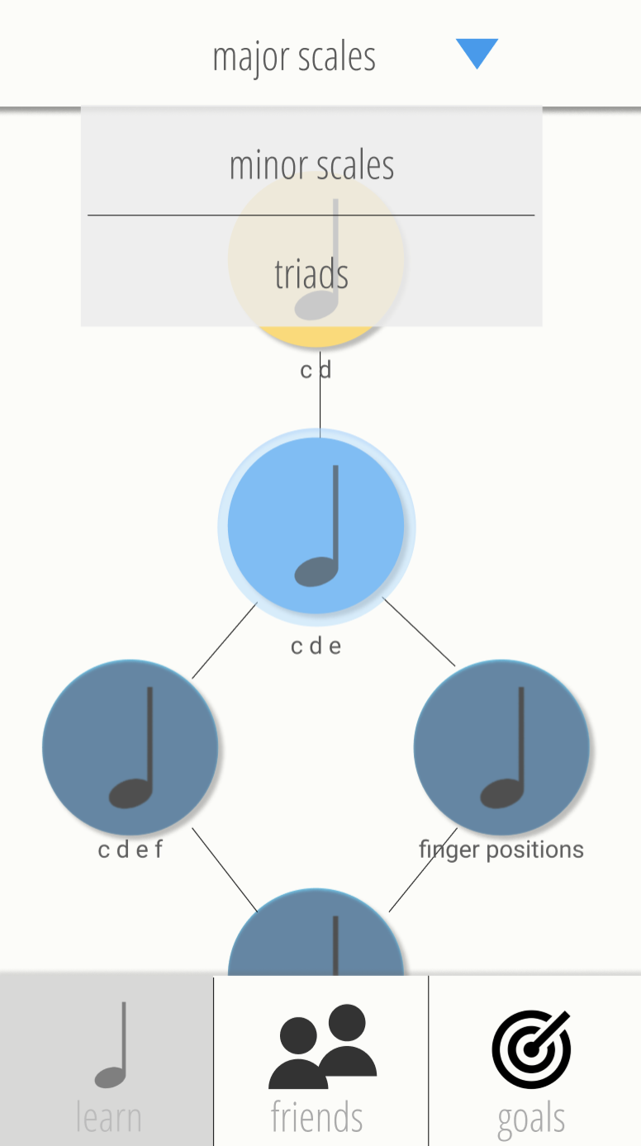
redesigns:
goal dropdown
Notes:
Selected INterface and rational Low-fi prototype structure (1 slide – mainly images)

Slide 20
change 3: clarify, unify, fun-ify lessons
Notes:
Selected INterface and rational Low-fi prototype structure (1 slide – mainly images)

Slide 21
issues:
progression unclear
difficult to asses what goals entail
Notes:
Selected INterface and rational Low-fi prototype structure (1 slide – mainly images)

Slide 22
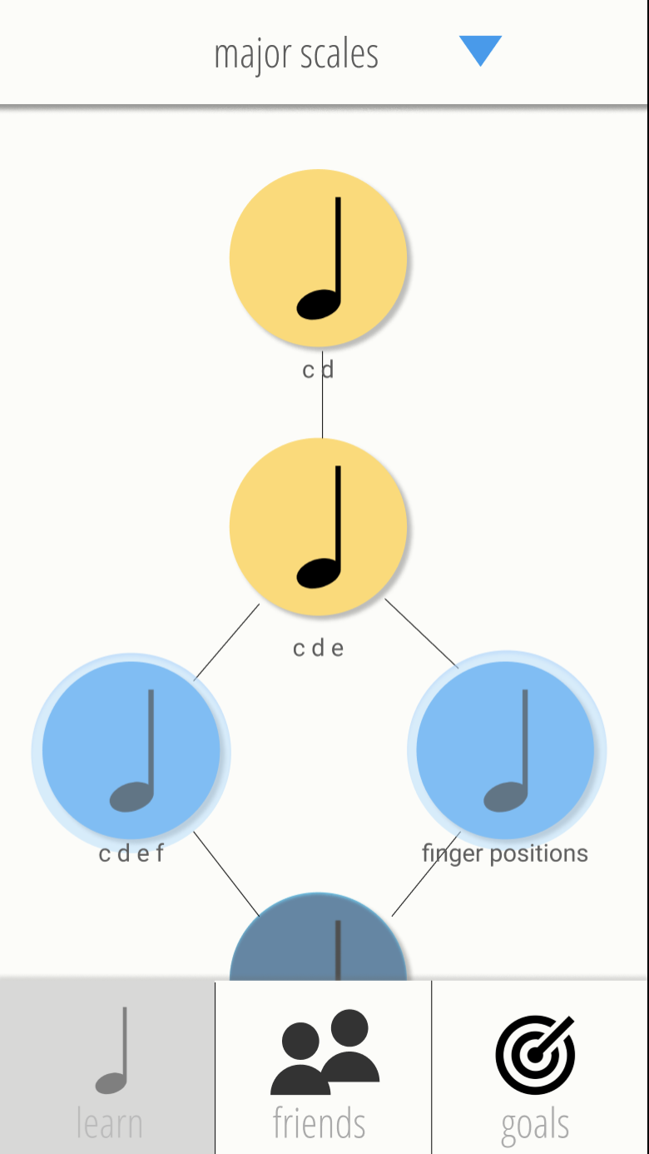
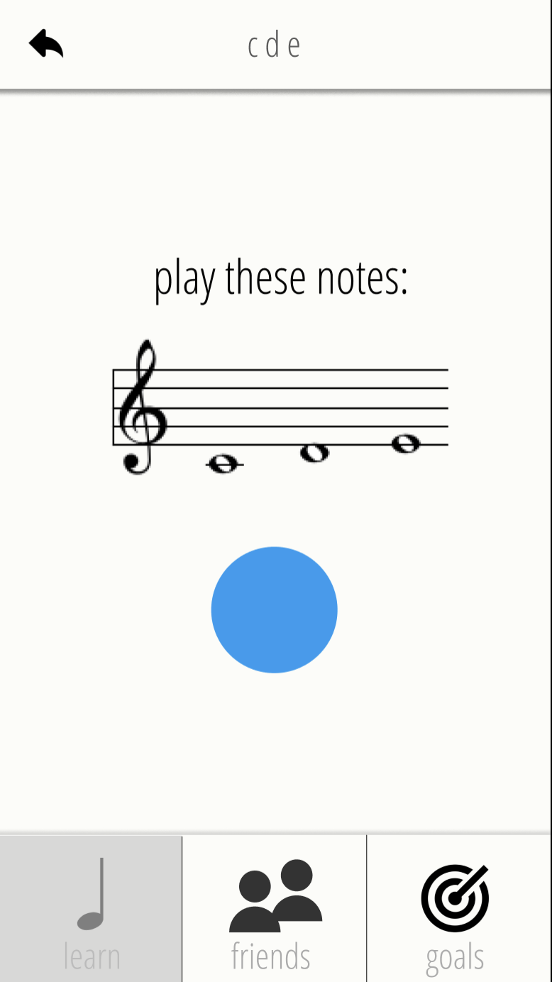
redesigns:
consistent circle paradigm
“delightful”completion
animation
indicative colors
Notes:
Selected INterface and rational Low-fi prototype structure (1 slide – mainly images)

Slide 23
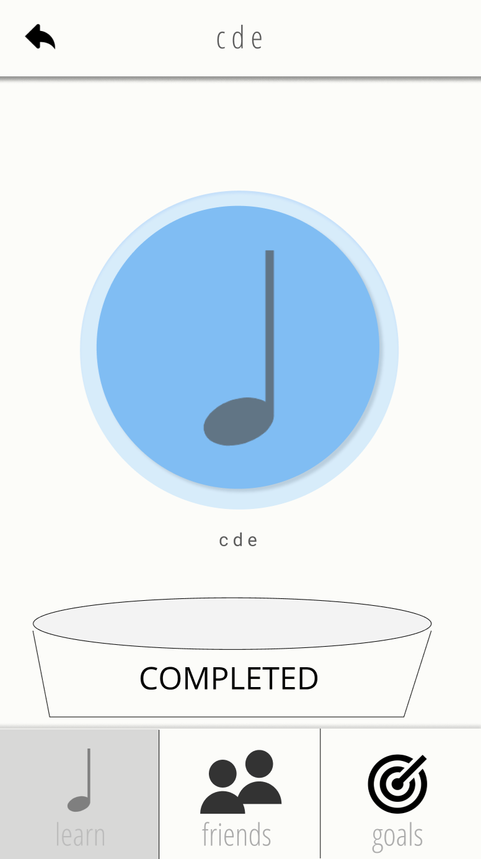
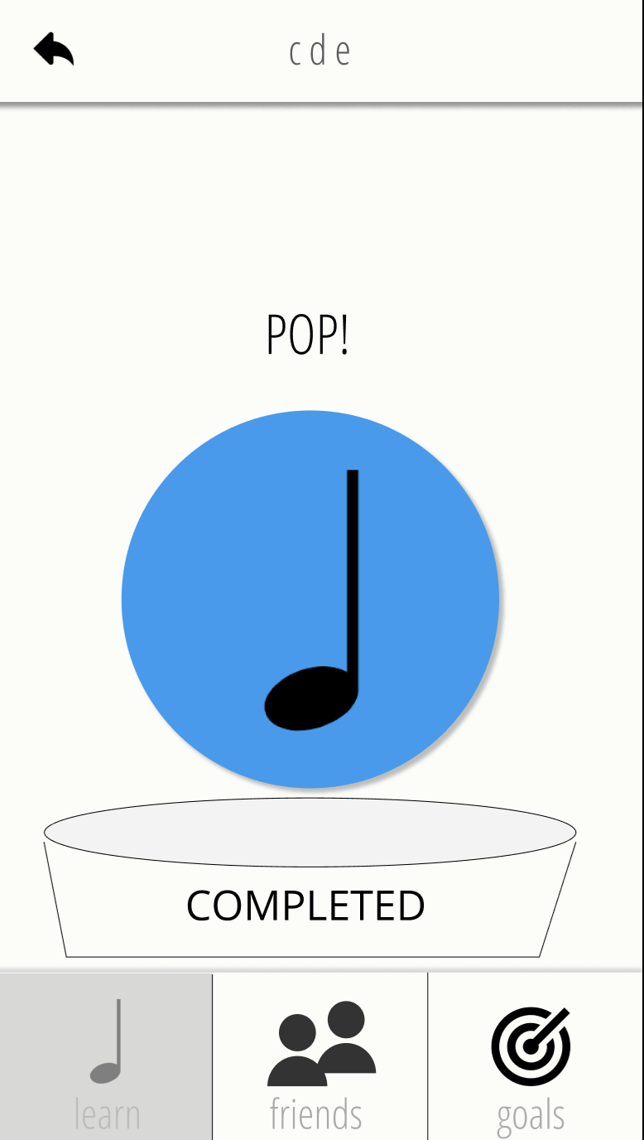
redesigns:
consistent circle paradigm
“delightful”completion
animation
indicative colors
Notes:
Selected INterface and rational Low-fi prototype structure (1 slide – mainly images)

Slide 24
revised interface design
task flows
Notes:
Selected INterface and rational Low-fi prototype structure (1 slide – mainly images)

Slide 25
learn new “skill bite”
Notes:
Selected INterface and rational Low-fi prototype structure (1 slide – mainly images)

Slide 26
add new goal
Notes:
Selected INterface and rational Low-fi prototype structure (1 slide – mainly images)

Slide 27
find friends
Notes:
Selected INterface and rational Low-fi prototype structure (1 slide – mainly images)

Slide 28
prototype overview
tools && limitations
(click here to play with it)
Notes:
Selected INterface and rational Low-fi prototype structure (1 slide – mainly images)

Slide 29
pros:
google docs version of Sketch
reusable components
prototyper build-in
cons:
free version only allows 2 collaborators (Khoi, David, Khoifan)
figma
Notes:
Selected INterface and rational Low-fi prototype structure (1 slide – mainly images)

Slide 30
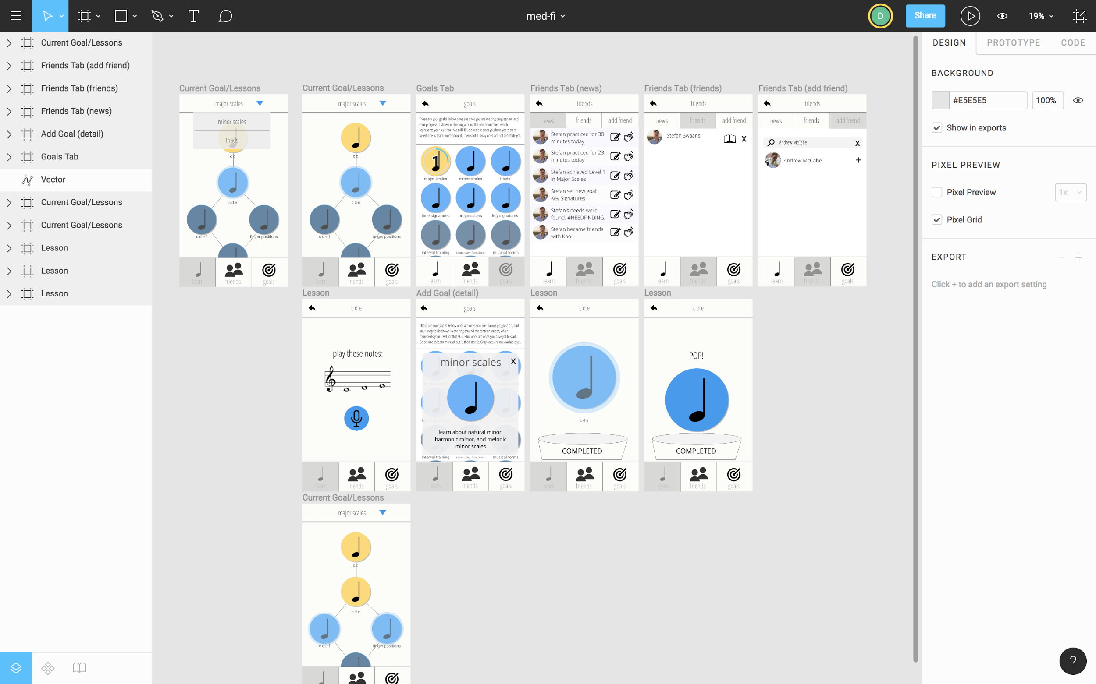

Slide 31
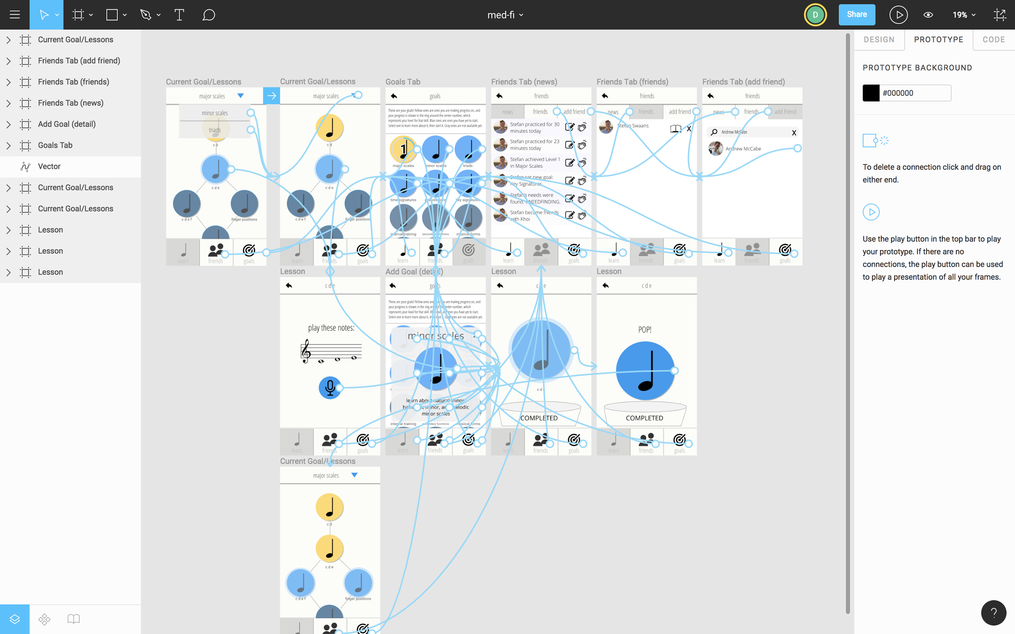

Slide 32
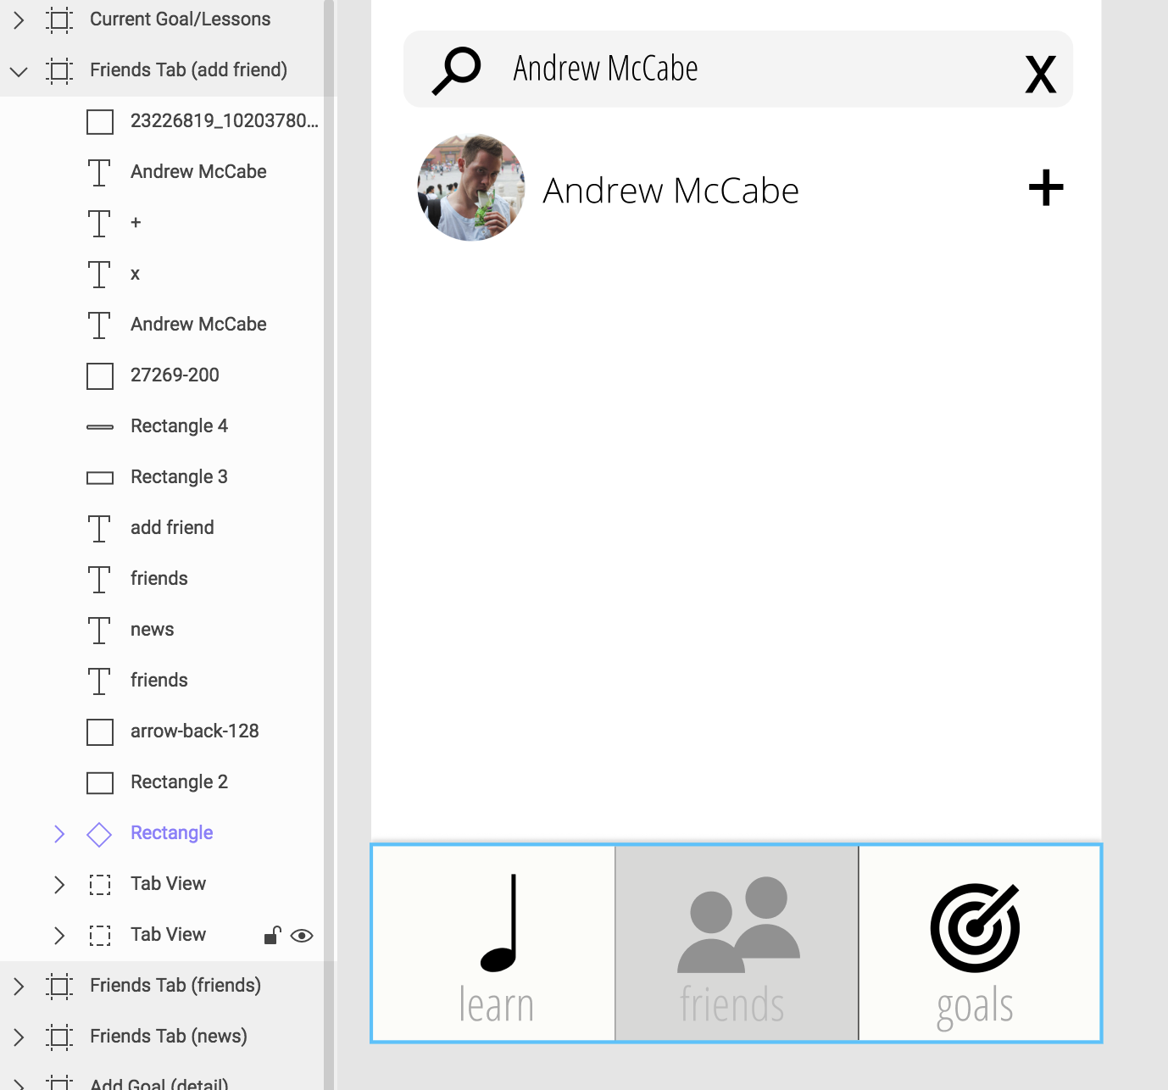
re-usable
components
Notes:
Selected INterface and rational Low-fi prototype structure (1 slide – mainly images)

Slide 33
unable to test “delighfulness” of interactions
hard coded, can’t adapt to skill level
can’t test follow through over time
limitations
Notes:
Selected INterface and rational Low-fi prototype structure (1 slide – mainly images)

Slide 34
Questions?

